Slide 1
Training – How to use
GlobalLink as a freelancer
The Language Intelligence Company
24.09.2026
Luise Mugrauer, Head of Language Production
Notes:
Ablauf:
Aufzeichnung
Alle stummstellen - Fragen im Chat
2. Hälfte Zeit für Fragen

Slide 2

Agenda
Goals of this training
Essential Tools & Links (Vendor Hub, GLE, GLT, ELC)
GLE (Access, accept and deliver submission, access PO, invoice)
GLT (Open, complete, troubleshooting)
Special requirements for Apostroph & changes
Trainings
Q&A
Notes:
Teilnehmer vorstellen! Mediziner und Fachübersetzer seit Jahrzehnten

Slide 3

Goals of this training
Participants are familiar with the tools that are essential when taking on assignments at TransPerfect, and have a basic understanding of how to access and use them.
Participants are aware of the support options available and were able to find answers to their questions regarding assignment handling.

Slide 4
Some Terminology to start
What is a submission and what do Aqua, Sapphire, GLE, GLT, PD even mean?
Submission is the job or task you accept within a workflow. It can come in many forms
    Available
    Reserved
    Ready
    In Progress
    Completed
    GLE stands for GlobalLink Enterprise (PD is just an old name for it) and
    The user interface comes in Aqua (grey, blue) or in Sapphire (white or black with couloured filters)
    GLT stands for Global Link Translate and is the browser-based CAT tool you are going to use
    You will access it directly from the job in GLE.
    The old name for it is TSO.
Notes:
What was centralized on myFREELANCE is now split between 2, but you get an embedded editor

Slide 5
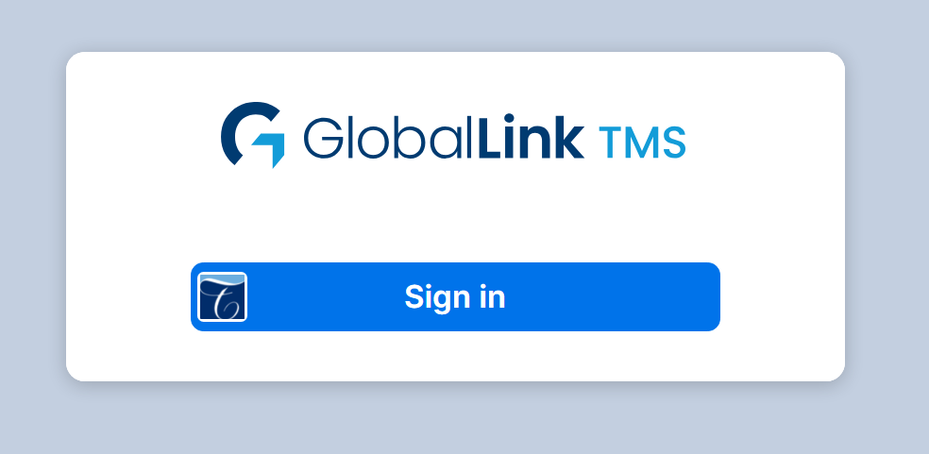
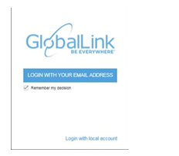

How to access the vendor hub, GLE and GLT
In order to access and claim a submission (= accepting a job) please go to:
https://gle-prod-ch.transperfect.com/Sapphire/view/dashboard
For the Vendor Hub go to
https://hub.transperfect.com/private
To access GLT (TSO) please go to an active submission and click on the «Open» button or with below link.
https://gl-switzerland.transperfect.com/TR/view/dashboard
Notes:
E-mail: e-mail you use to log into the TransPerfect Vendor Hub.
Password: Please use the same SSO (Single Sign On) login password you created earlier for the Vendor Hub, ELC and/or Gateway
You can change between Aqua and Sapphire

Slide 6
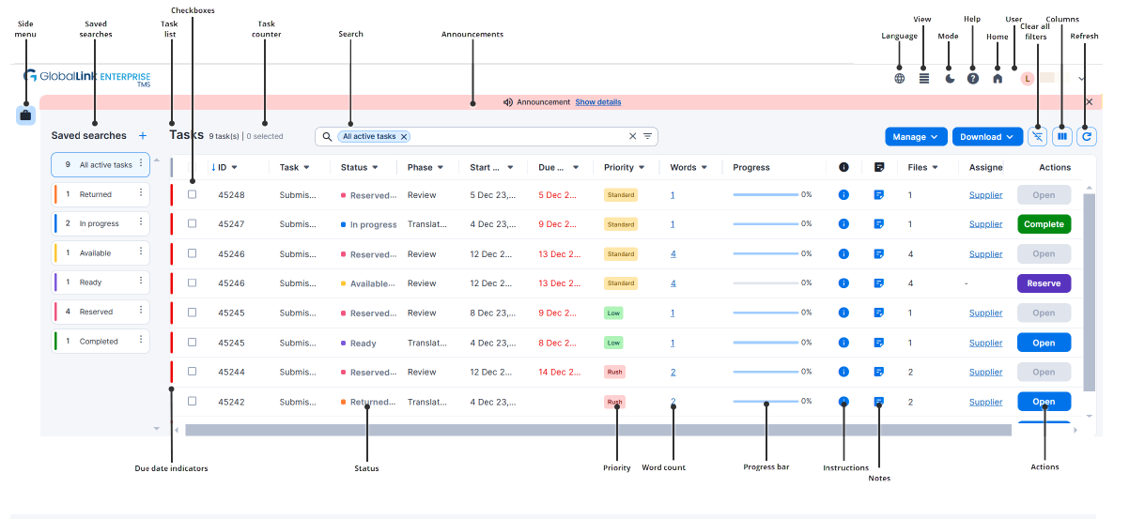
GLE in all its glory
Notes:
optimized for Google Chrome

Slide 7
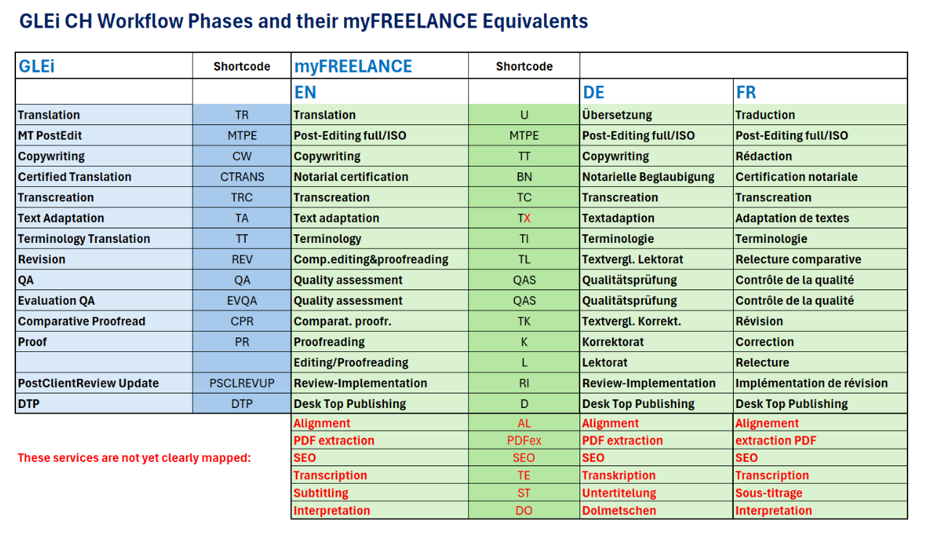

Slide 8
New setup:
Project claiming with project prices via GlobalLink – invoicing through the TransPerfect Vendor Hub.
Regarding payment for these projects:
In GlobalLink, you will receive a project-based offer for each assignment.
These offers will be based on standardised average Apostroph rates per language combination.
You can choose whether or not to accept the assignment. Or you can negotiate an offered job.
The Project Manager will confirm or decline the offer.
06
Changes in how jobs are priced in GLE

Slide 9
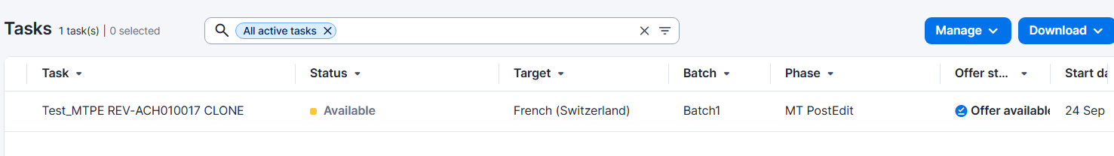
How to claim a submission – 1
In order for you to claim a submission please follow these steps:
Open the GLEi Portal.
In the list « Available » you will see any jobs that have been assigned to you and that you can claim.
BEFORE you claim always click on « Offer available » to first see the price for the task and the volume!

Slide 10
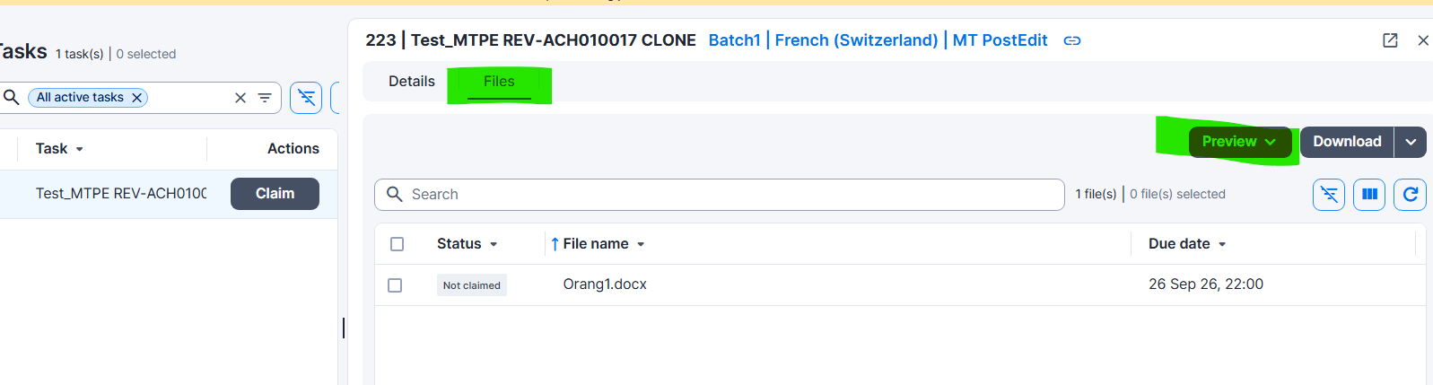
How to claim a submission – 2
ALSO always open the files first to see whether you are the right person for the job.
Double-click on the submission and go to « Files ». Then click on Preview > all Files in GLT
Notes:
We cannot change the price after the task has been claimed

Slide 11
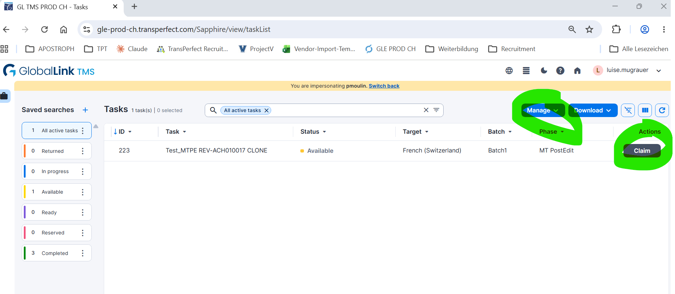
How to claim a submission – 3
When you are ready to claim the task and start working, click on «Claim » or the « Manage » button.

Slide 12
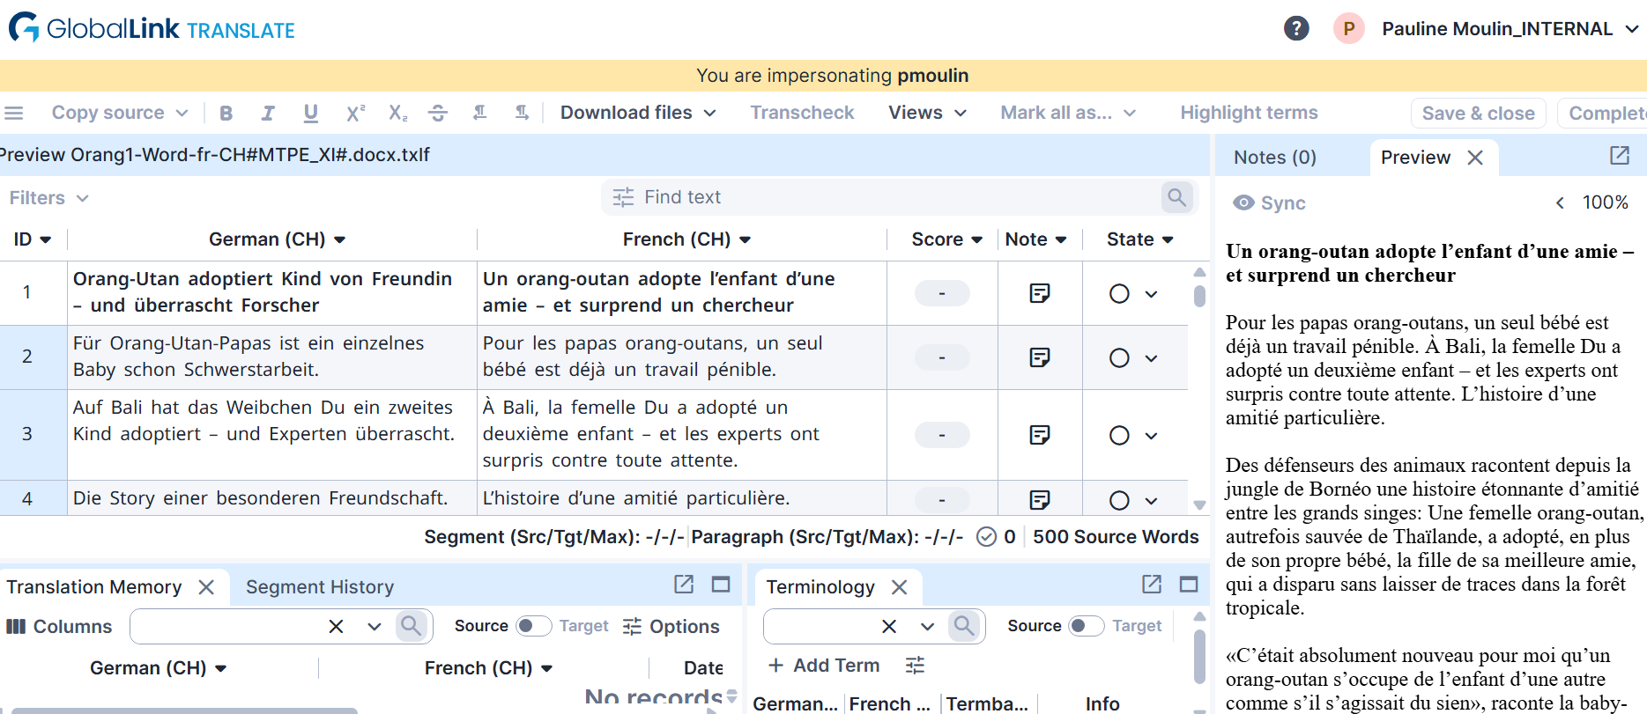
How to work on a job in GLT
Notes:
Try files in GLT first. If you encounter problems, try opening them in TSO (older version, moe stable but less features).
When you open GLT Edge seems to work best
For TSO Chrome seems to be good
General Help: https://glknowledge.transperfect.com/globallink-enterprise/enterprise

Slide 13
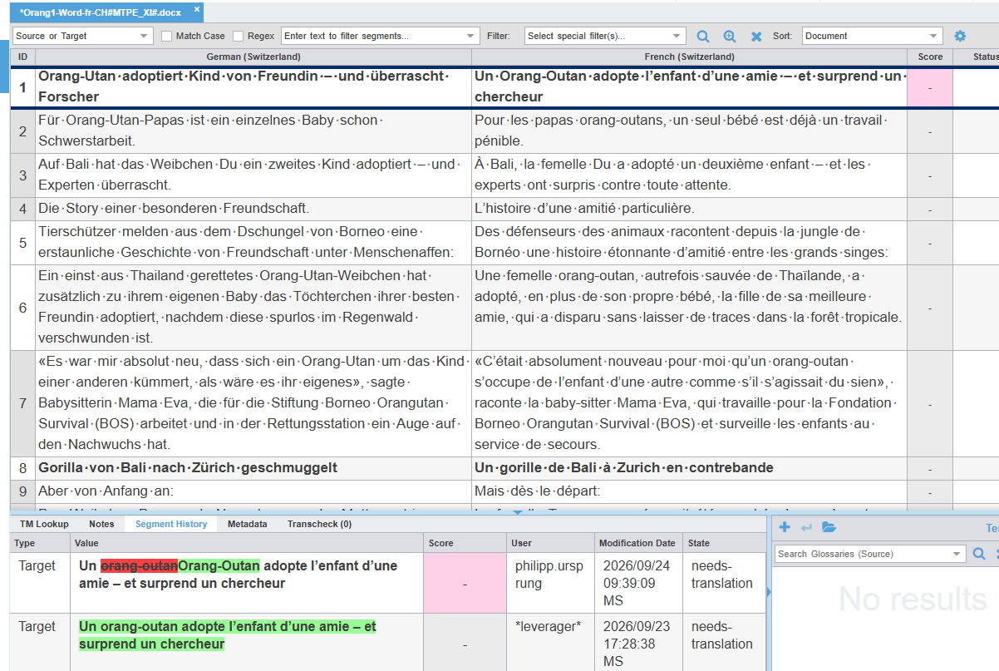
Track changes
Question :
Where can I see the track change mode in GLT?
Anwser:
this is only available or revision tasks, not MTPE.
Notes:
Im GLT/TSO für T, MTPE gibt es keine Möglichkeit im TC-Modus zu arbeiten. Im unteren Teil des Fensters gibt es die "Segment History", wo du deine Änderungen sehen kannst (siehe Screenshot).
Wenn du eine TC-Version brauchst, kannst du sonst das Output des MTPE mit "Download Target Preview" speichern, dann auch die finale (geänderte) Version herunterladen und ein "Compare Documents" machen.

Slide 14
Important reminder for Apostroph clients
    We use 2 engines: apoAI through a workaround and the standard TPT engine
    Please check the output BEFORE you accept the task (claim). A price amendment can only be done upfront not afterwards like we could in mFREELANCE
    Please follow our usual guidelines for Post-editing
Handling of MTPE

Slide 15
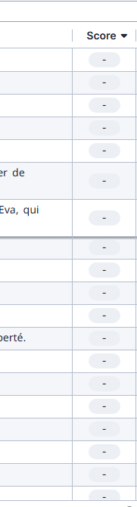
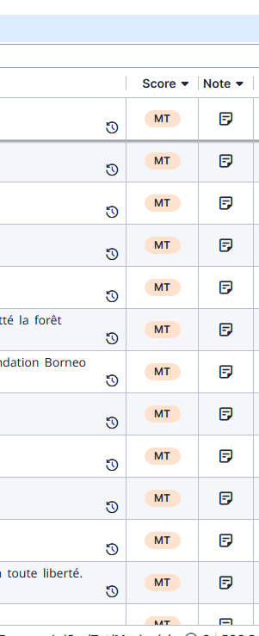
apoAI Output vs – standard TPT output

Slide 16
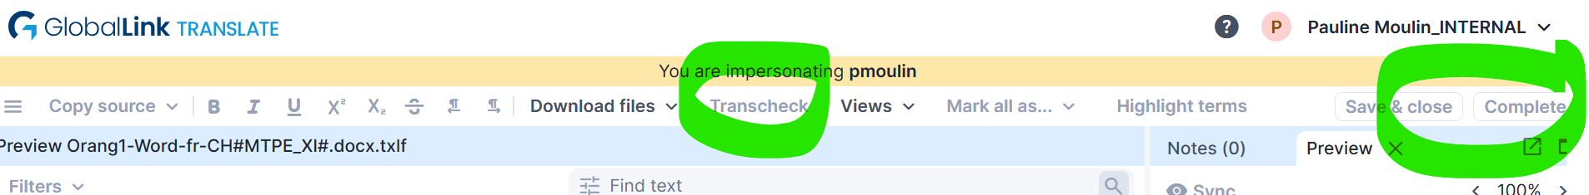
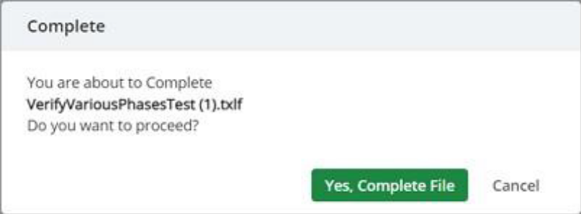
How to complete a job in GLT
In order to complete your task and deliver to the Project Manager you need to :
Complete the project in the GLT Editor
Do the Transcheck and download the report.
Download the target files and check these.
Afterwards you click on Complete.
Notes:
Complete is 2 parts!
This step uploads the file to GlobalLink Enterprise and changes its status to uploaded and closes the GlobalLink Translate or Review page. The file does not move to the next workflow phase until you also complete it in GlobalLink Enterprise.

Slide 17
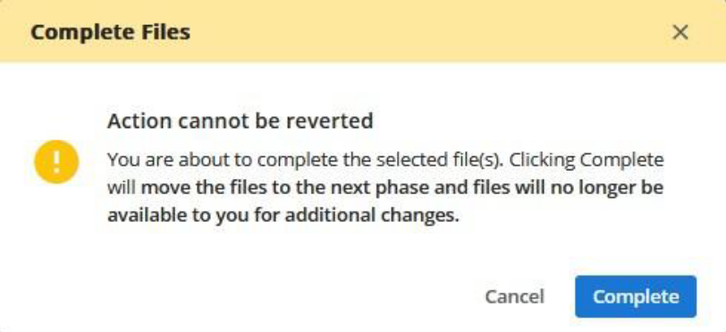
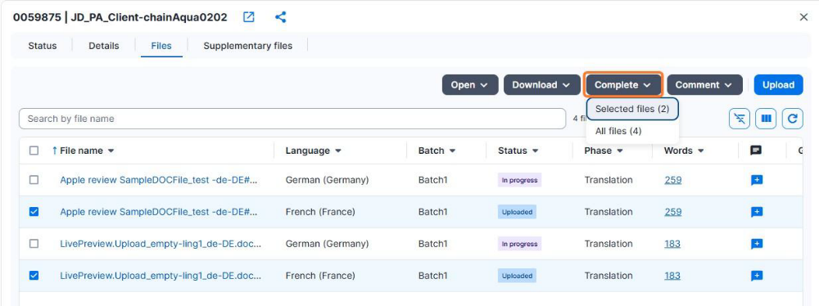
How to complete a submission/job and upload files
You also need to complete the submission in GLE to move the files along to the next step in the workflow (Review or Q Check by the PM).
From the GlobalLink Enterprise Drawer, on the Files tab, select the uploaded file(s)
Upload any Supplementary files (checked target files, Transcheck report)
In the « Complete » Dropdown you select the file and click on «Complete».
Notes:
Complete is 2 parts!
Completing the file(s) from GlobalLink Enterprise changes the files status from Uploaded to Completed and moves the workflow to the next phase.

Slide 18
Important reminder for Apostroph clients
    Completing a Transcheck (the QA Checker equivalent for Trados) and sending the report through Supplementary files is mandatory
    Checking the target files in their original format through download and upload in Supplementary files is still mandatory
Transcheck and Target files

Slide 19
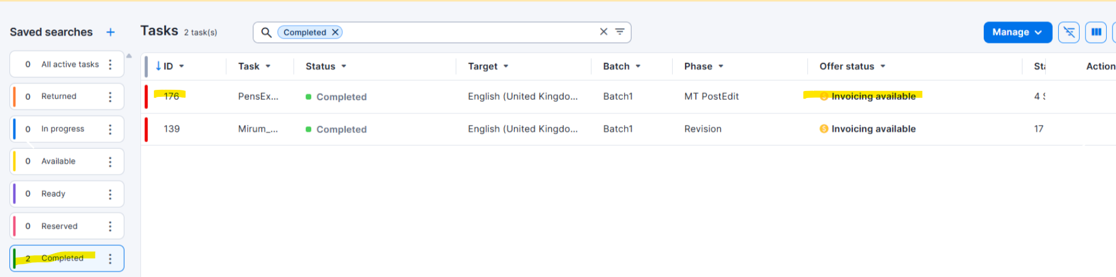
How to invoice a submission/job in the TransPerfect environment – 1
After completion of the project, the Project Manager creates your PO.
Once this is done, you can open/download your PO for this job:
Open the GLEi Portal.
Open the completed projects
Click on Invoicing available in the job no., here it is 176.
Notes:
Some PrMs do it right away after delivery. But in our case it will usually be after the project was delivered to the client which is usually not far after.

Slide 20
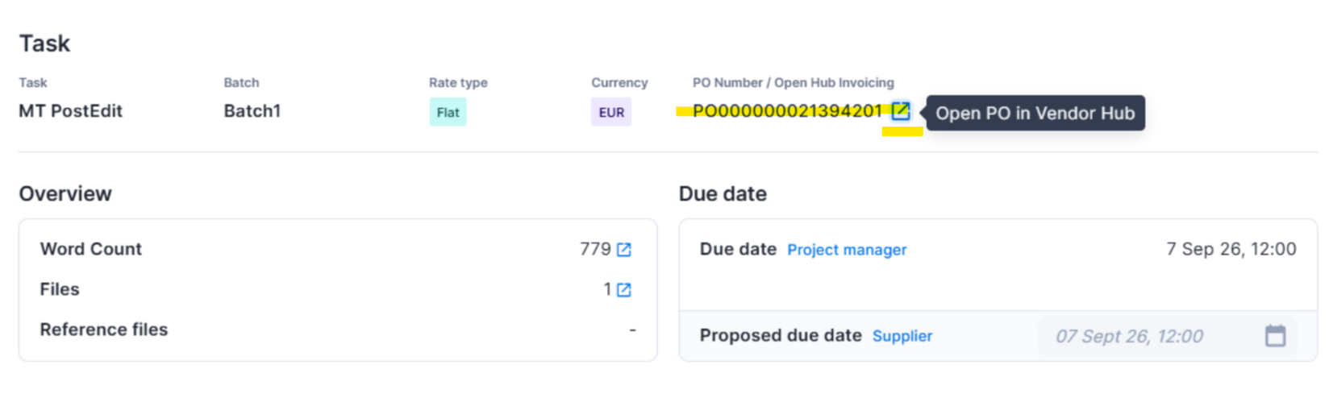
How to invoice a submission/job – 2
As a window will open, click on the small blue box with an arrow near the PO number.
Another window will open, where you can download your PO for this job or open it directly in the Vendor Hub.
You then invoice the job in the Vendor hub under « Invoices and payments »

Slide 21
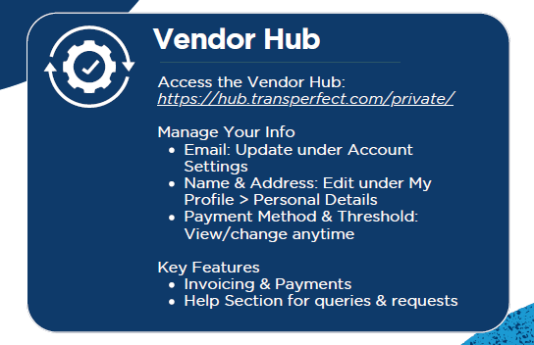
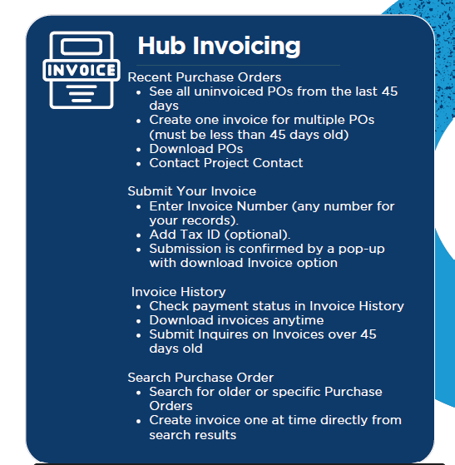
How to invoice a job and get paid

Slide 22
GLE & GLT Troubleshooting
05
Troubleshooting
    First contact for general help with a project
    freelance@apostrophgroup.ch
    → Please cc the Project Manager, add the submission ID + a short description of the problem.
    If we cannot fix the problem ourselves, we will escalate to the TPT support.
2nd-level support e.g. in case of urgency/out of hours:
pdinternal_tdc_vendors@translations.com

Slide 23
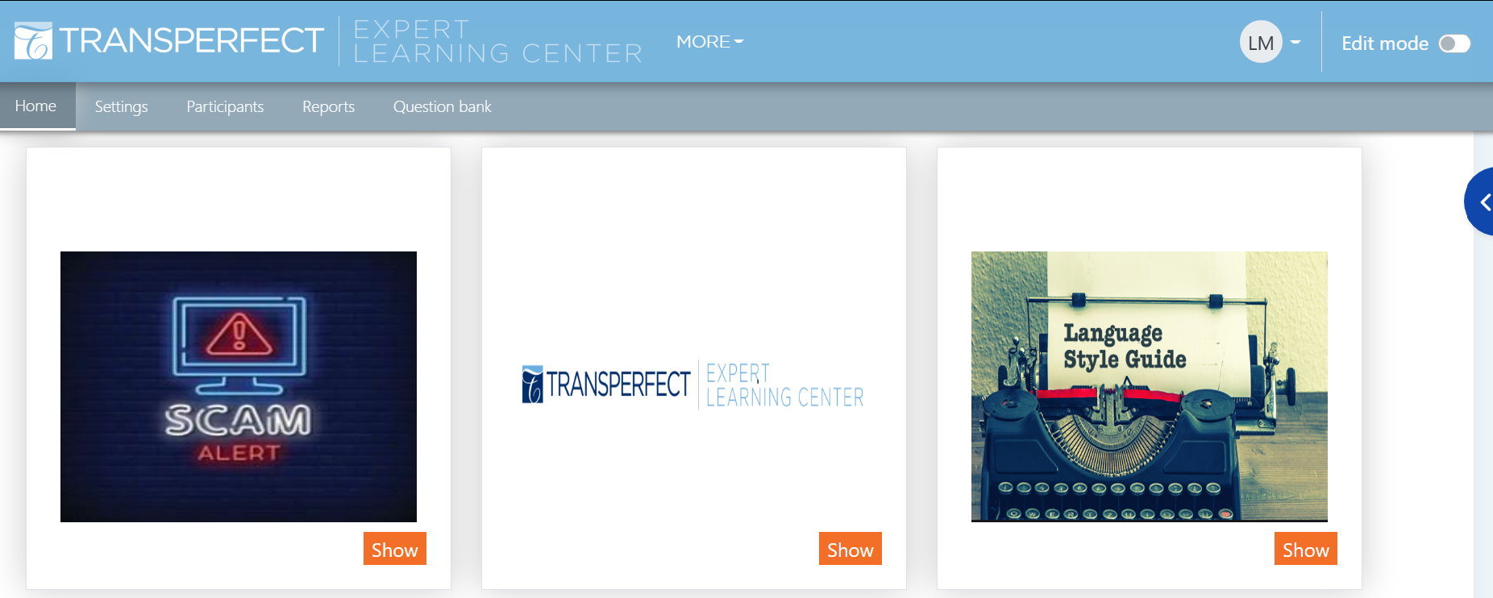
Useful trainings and Help material
07
Trainings
Onboarding Training
Course: GLE Sapphire | ELC

Slide 24

Questions & Answers
Please send your questions in the Q&A chat

Slide 25

Thank you!
The Language Intelligence Company
Your Vendor management team:
Luise Mugrauer, Sabina Wermelinger & Melis Erdem
freelance@apostrophgroup.ch
+41 (44) 265 40 39

